Slide 1

3M™ Industrial Packaging Tape Guide
SPR University

Slide 2

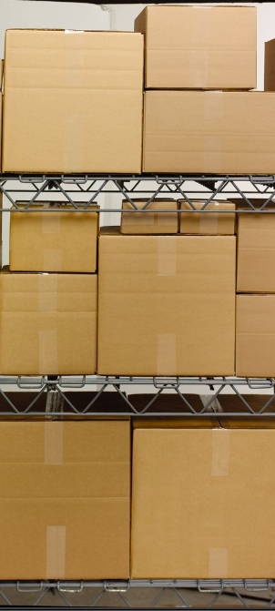
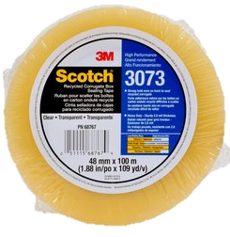
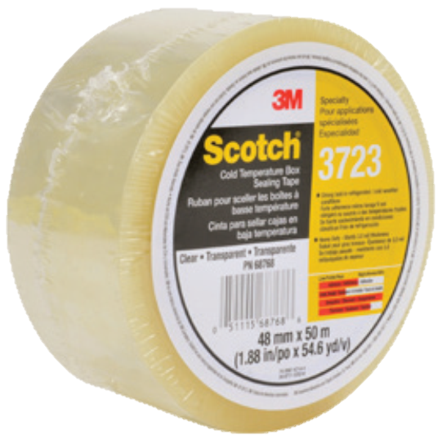
3M™ Industrial Packaging Solutions…
The global resource for containment, protection & communication
Scotch® Box Sealing Tapes offer 3M’s very best performance in packing tapes. They are made with abrasion-resistant backings that resist moisture and scuffing. These tapes also offer high edge-tear and split resistance.
Scotch® and Tartan™ Box Sealing Tape Types
General Use Tapes
GO-TO Tapes (Medium Duty)
High Performance Tapes
Recycled Corrugate Tape
Cold Temp Tape

Slide 3
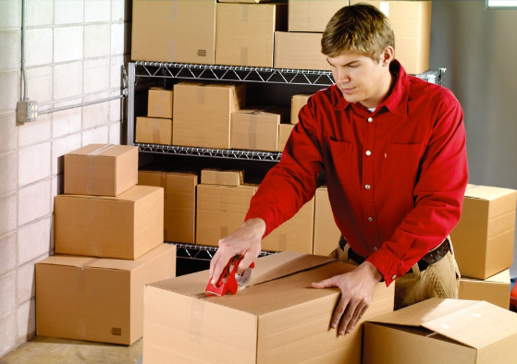
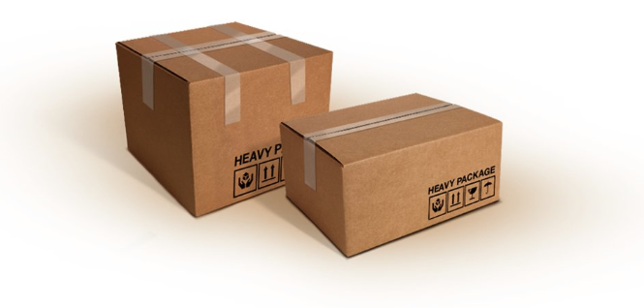
Where do I use 3M™ Industrial Packing Tapes?
Where?
3M™ Industrial Tapes are most commonly used in “off carpet” locations where large quantities of boxes are being packed and shipped.
  Mailroom
  Backroom/Facilities Areas
Who?
  Mailroom staff
  Maintenance workers
  Warehouse workers

Slide 4

What Tape Should I Use?
How to Choose the Right Tape for Your Application
Step 1: Assess Your Situation
Step 2: Choose Tape Backing
Step 3: Select Tape Adhesive

Slide 5
How to Choose the Right Tape for Your Application
Step 1: Assess Your Situation
What width of tape are they currently using?
2 in (48mm), 3 in (72mm)
What is the Value of Contents:
High end electronics, pharmaceuticals, medical devices?
If carton opens any pharma drugs is quarantined and returned through a formal process
What are you shipping?
Individual shipments, palletized or unitized pallets?
Truck, UPS
What is the environment of the shipping area?
Cold, damp, hot, humid, dusty
How heavy is your filled box?
Over packed/under packed
BOTTOM LINE! Cost of Tape Failure is Critical

Slide 6
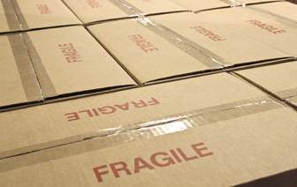
How to Choose the Right Tape for Your Application
Polyester
Strongest backing
Excellent abrasion resistance
Moisture and chemical resistance
Highest temperature resistance
Transparency
Polypropylene
Strong backing
Good abrasion resistance
Good conformability
Most economical
Transparency
Step 2: Choose Tape Backing
Tape Configuration
Backing
Surface Treatment
Adhesive
*Surface Treatment -Anchors the adhesive to the backing

Slide 7
How to Choose the Right Tape for Your Application
Synthetic Rubber
Excellent holding power
Good initial adhesion above 40°F
Environmentally preferred due to solvent free construction
Acrylic
Excellent initial adhesion over a broad temperature range
Extremely long performance life
UV and chemical resistance
Step 3: Select Tape Adhesive
Tape Configuration
Backing
Surface Treatment
Adhesive
*Surface Treatment -Anchors the adhesive to the backing

Slide 8
3M Industrial Tape Offering Guide
*Pressure sensitive tapes coated with synthetic hot melt adhesive systems have much higher shear holding power values than tapes coated with acrylic adhesive systems

Slide 9

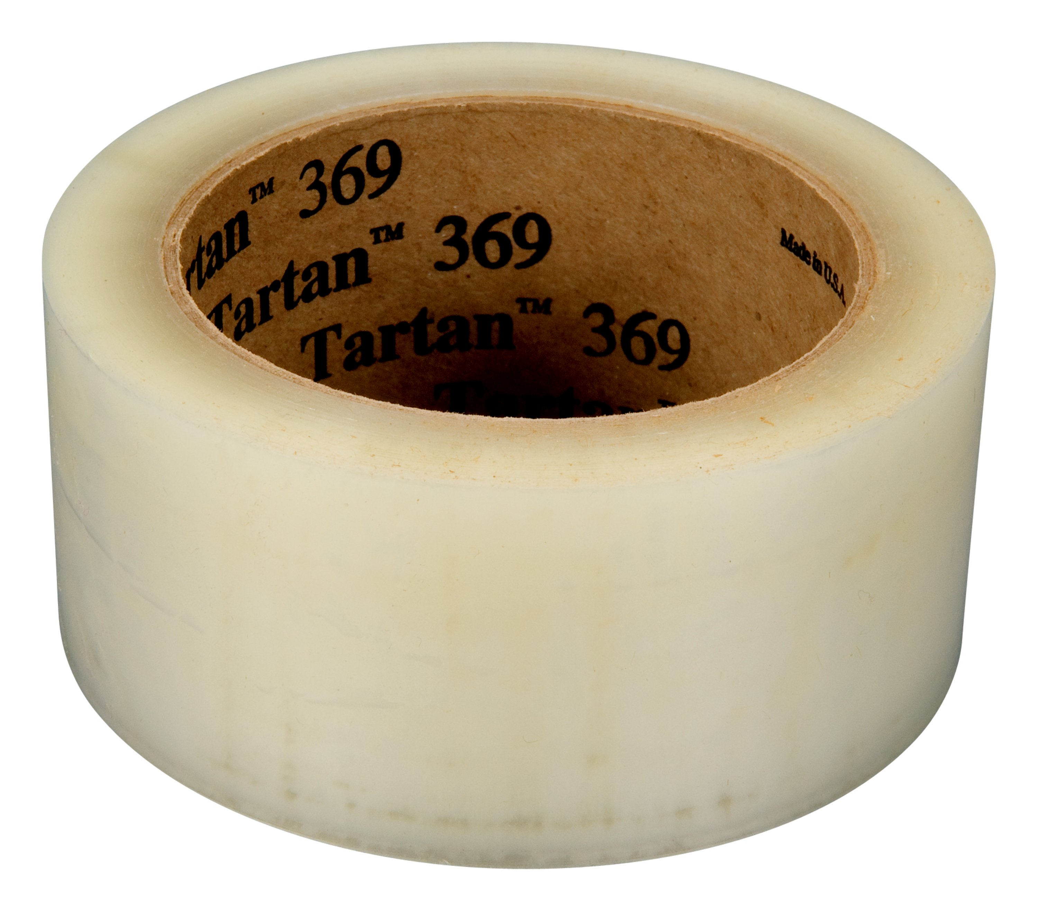
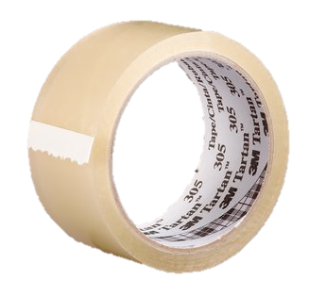
General Use Tapes (Light Duty)
369 and 305 are light duty tapes used for general purpose packaging applications
Tartan® Box Sealing Tape 369
Tartan® Box Sealing Tape 305
Application: Suitable for use on lightweight envelopes and mailers
Adhesive sticks to a variety of surfaces on contact, including fiberboard
Polypropylene backing withstands nicks, abrasions and moisture for long-lasting performance
1.6 mil total thickness
Application: used for general purpose packaging applications
Acrylic adhesive sticks to a variety of surfaces on contact
Sufficient holding power resists popping for a secure seal throughout the supply chain
Polypropylene film backing for long-lasting performance
  1.8 mil total thickness

Slide 10

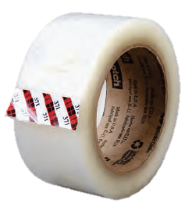
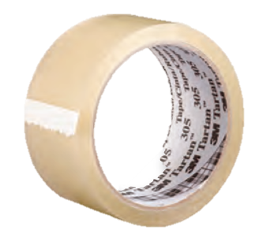

GO-TO Packaging Tapes (Medium Duty)
371 and 311 are medium duty tapes recommended for use on regular slotted containers weighing up to 70 lbs.
Scotch® Box Sealing Tape 371
Application: Sealing boxes exposed to moist conditions
Polypropylene with synthetic rubber adhesive for excellent holding power
Resistance to moisture in storage and shipping
1.9 mil total thickness
Scotch® Box Sealing Tape 311
Application: Box packing, sealing and storage below 40ºF
Polypropylene with acrylic adhesive for reliable closure in cold temperature and damp conditions
Light to medium weight boxes
2.05 mil total thickness

Slide 11

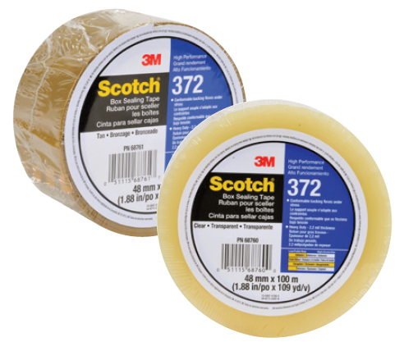
Scotch® High Performance Packaging Tapes
372 and 373 are heavy duty tapes used for heavy, hard-to-seal and over-packed boxes
Scotch® Box Sealing Tape 372
Scotch® Box Sealing Tape 373
Application: High Performance Tape ideal for heavy packages
Polypropylene with synthetic rubber adhesive for reliable closure
Polypropylene conforms securely over rough edges
  Ideal for palletized and unitized loads
  2.2 mil total thickness
Application: High Performance Tape ideal for heavy packages and double walled boxes
Polypropylene with synthetic rubber adhesive for reliable closure
Adhesive sticks quickly
  2.5 total thickness

Slide 12
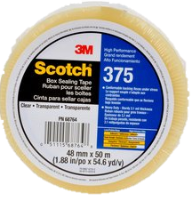
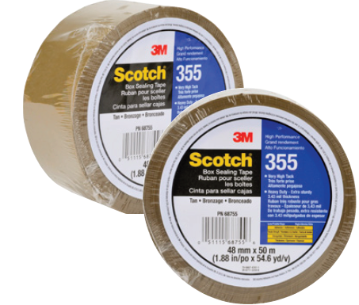
High Performance Packaging Tapes
375 and 355 are the strongest heavy duty tapes, 355 is the strongest offering
Scotch® Box Sealing Tape 375
Scotch® Box Sealing Tape 355
Application: High performance, ideal for shipping heavy packages including over-packed, double or triple-walled boxes
Polypropylene with synthetic rubber adhesive for reliable closure
Polypropylene conforms securely over edges
  3.1 mil total thickness
Application: Super strong, super tacky tape great for use on hard-to-seal surfaces, high humidity environments and double or triple walled boxes
Polyester with synthetic rubber adhesive
Securely closes double/triple walled cartons and fiberboard
3.43 mil total thickness

Slide 13
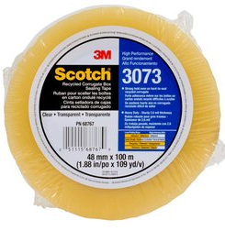

Recycled Corrugate Tape
3073 is best used on boxes with high recycled content and for boxes exposed to moist conditions
Average Box has 46% recycled content
Scotch® High Performance Recycled Corrugate Tape 3073
Polypropylene with synthetic rubber adhesive (softer adhesive) that penetrates the shorter fibers and bonds instantly to recycled corrugate cartons
10% Bio-based content adhesives
Penetrates the hills and valleys of the substrate
Excellent holding power
Recommended for use on regular slotted containers RSC weighing up to 100 lbs.
2.6 mil total thickness

Slide 14

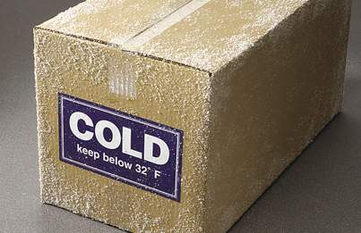
Cold Temperature Box Sealing Tape
3723 is best used when shipping or storing boxes in temperatures below 40˚F
Scotch® Cold Temperature Box Sealing Tape 3723
Polypropylene with modified synthetic rubber adhesive
Resists abrasion, moisture and chemicals
Strong hold in refrigerated and cold weather conditions
Excellent for sealing double or triple walled cartons
Meets FDA requirements for indirect food contact
3.0 mil total thickness

Slide 15
Additional Information

Slide 16
SPR Product Offering Reference

Slide 17
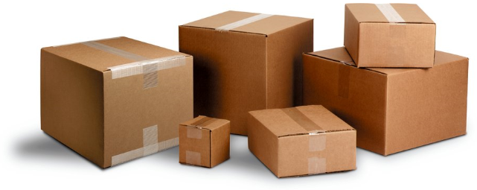
Box Sealing Adhesive Properties Reference
Synthetic Rubber Resin Adhesive
Excellent shear
Good initial tack at room temperature
Low UV and chemical resistance
Sufficient aging
Environmentally preferred due to solvent free construction
Better appearance and smell than natural rubber
Highest room temperature shear holding power
Adequate aging properties
Consistently reliable performance
Acrylic Adhesive
Low shear Holding Power
Excellent initial tack at room and cold temps
Excellent UV and chemical resistance
Roll appearance generally superior to natural rubber and synthetic hot melt box sealing tapes
Excellent UV and solvent resistance
Odor sometimes a problem
Long aging properties

Slide 18
Critical Fundamental Properties of Pressure Sensitive Adhesives for 3M Box Sealing Tapes
Shear - Major Box Flap Closure Power
Critical in keeping box
closed during entire shipping cycle
Tack - Initial Adhesion
Critical in first moments of Tape application
Tape loop,
adhesive side out
Lateral force holding power
Fiberboard surface
Fiberboard surface

Slide 19
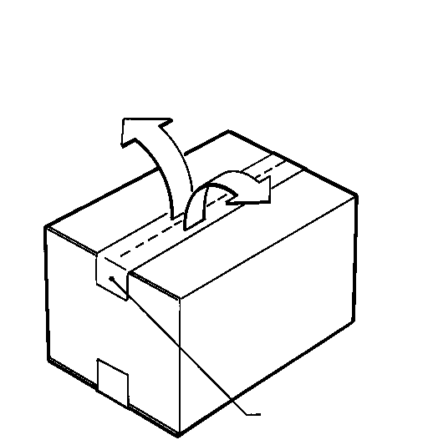
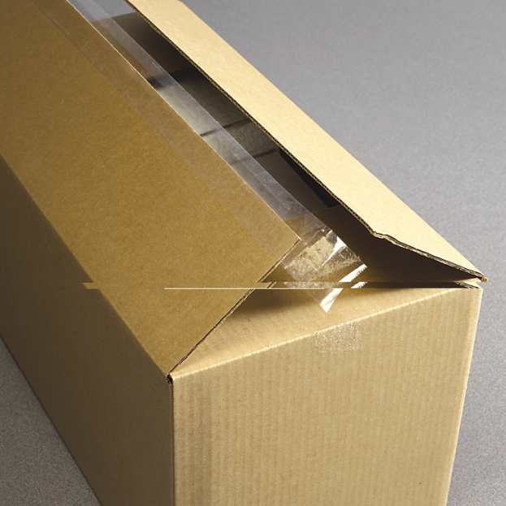
What is Shear?
Shear Holding Power Keeps the RSC Closed
Shear is critical in keeping shipping cartons securely closed during the shipping cycle. This is where 3M’s performance consistency delivers added value to customers who close their shipping cartons with 3M Industrial box sealing tape products
FACT: Shear Holding Power is Critical
Flap Force
WHY? Because it…
Keeps the tape end legs in place
The flaps securely closed
Cartons more firmly sealed throughout the shipping cycle
Tape in Shear
Shear Holding Failure

